Slide 1


Cyber Security for National Critical Infrastructure
Initial Mlambo | A/Technical Director | TelOne Public Lecture on Cyber Security

Slide 2
Introduction to Critical National Infrastructure (CNI)
Critical National Infrastructure (CNI) refers to the systems, networks, and assets that are essential for the functioning of a country and its economy.
Transportation Systems
Water and Sanitation Systems
04
Telecommunication Systems
03
05
Healthcare Systems
Energy Sector
02
06
Financial Systems
Government Systems
01
07

Slide 3
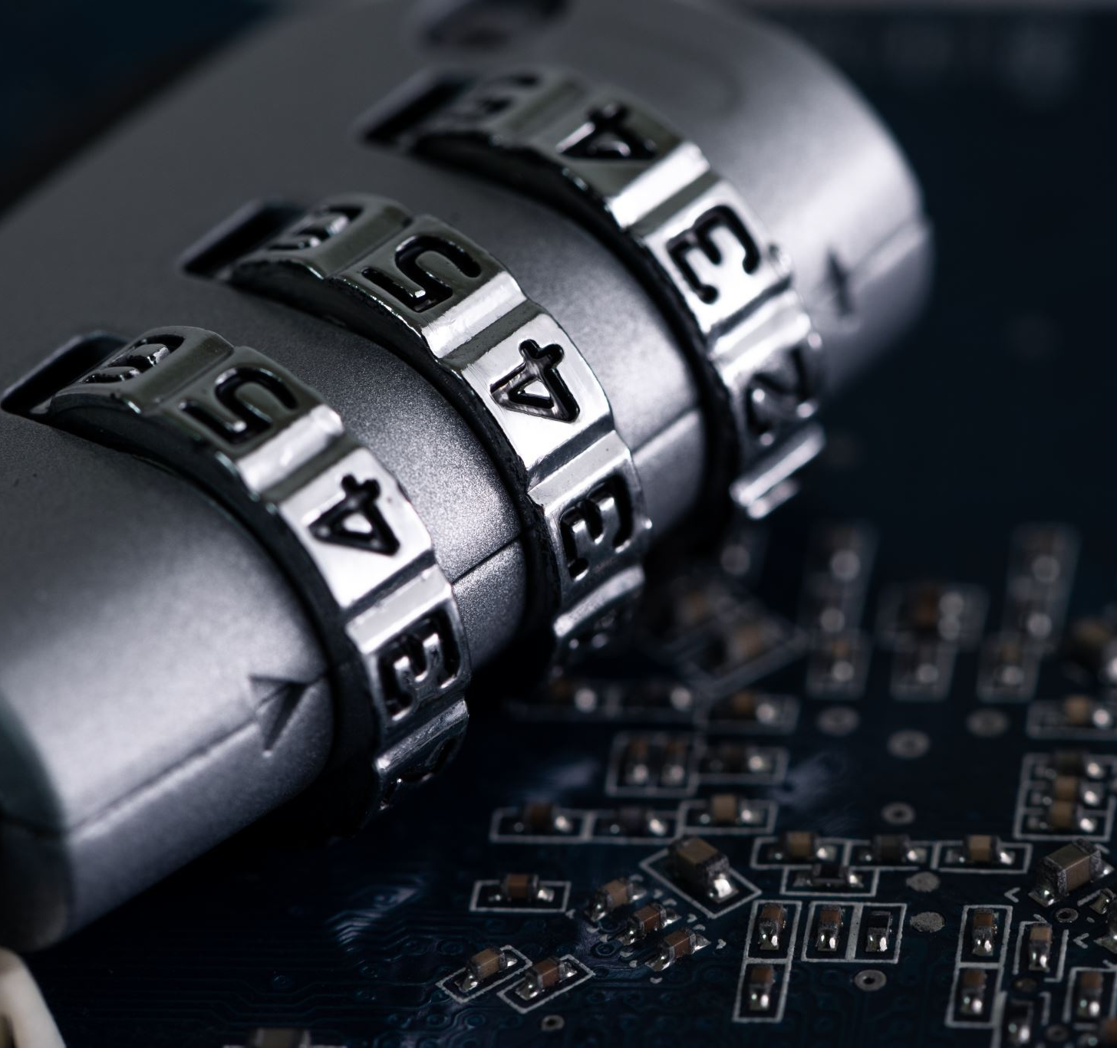
The Significance of CNI Security
Protecting CNI is imperative, as any disruption can result in substantial economic losses, interference with supply chains, and damage to essential systems, making it crucial for both economic stability and national security.
Consequences of a cybersecurity breach in CNI are:
Economic Disruption - trade, economic stability, national prosperity.
National Security Risk – defence and intelligence disruption.
Loss of Trust in Institutions and Government.
Public Safety Threats.
Critical Service Outages.
Social Unrest and Panic.
Severe environmental damage.
Deterioration of International Relations:
Increased Cybercrime and associated financial losses.

Slide 4
Justifications for Cybersecurity Investment
01
05
Preserving public trust and confidence
Safeguarding critical infrastructure
02
06
Protection of financial systems
Preserving investor confidence
03
07
Defence against economic espionage
Intellectual property protection
04
08
Protection against cyber threats
Business continuity and resilience

Slide 5
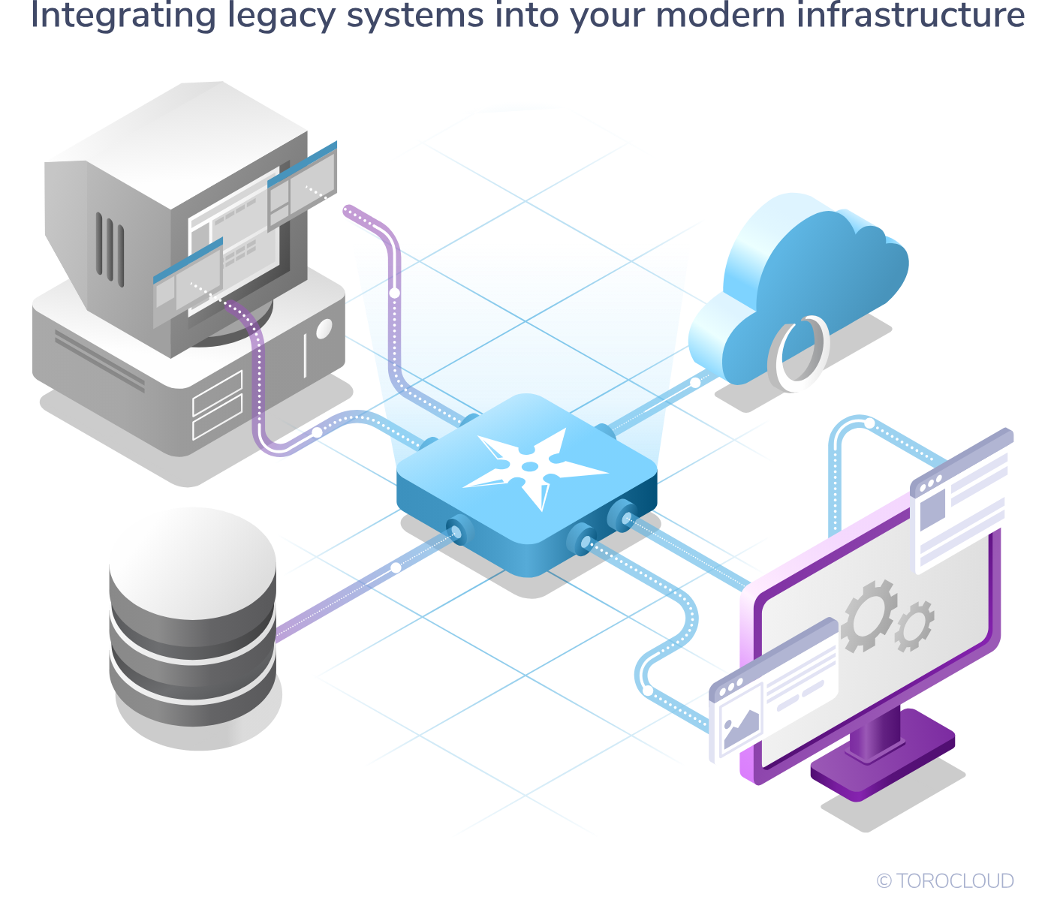




Threat Landscape for Critical Infrastructure
Physical Security
Legacy Systems and Infrastructure
Lack of Security Awareness training
Attacks on physical infrastructure, such as power plants or transportation systems, can have cascading effects on the digital systems that support them.
Many CNI systems still rely on legacy technologies and infrastructure that may have vulnerabilities or lack proper security controls.
Insufficient cybersecurity awareness and training among CNI employees can lead to unintentional actions that compromise security.
Cyberattacks
Insider Threats
CNI is a prime target for cybercriminals, hacktivists, and nation-state actors
CNI organizations need to be vigilant about insider threats, where employees or contractors with authorized access may intentionally or unintentionally cause harm.

Slide 6
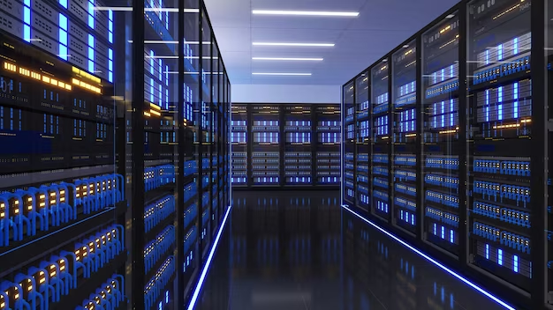
Cyber Adversaries Targeting CNI
01
02
Internal Adversaries
External Adversaries
Conventional types of attackers, such as criminals, nation-states, and other threat actors, that exist outside of an organization.
They employ various techniques from the MITRE ATT&CK® matrix to execute their tactics, which include compromising credentials, hijacking browser sessions, or extracting data from local systems or shared drives
Covers more than just malicious insiders, also includes any user within an organization whose actions knowingly or unknowingly compromise security, or who has been compromised without their knowledge.
This involve employees who are unaware of or indifferent to the security operation team’s security protocols and create vulnerabilities.
03
04
Endemic Adversaries
Endemic Adversaries
Endemic adversaries are decision-makers within an organization who have embedded processes, policies, and priorities that do not support the detection and response to threats. Examples of endemic issues include:
Reluctance to invest in cybersecurity infrastructure
Accumulation of tech debt and legacy systems
Poor management of third-party partners, contractors, or vendors
Ineffective consolidation after mergers and acquisitions
A pervasive culture of org conflict and politics

Slide 7

Threat Actors and Attack Vectors
Cyber Espionage
Malware and Malicious Code
Denial-of-Service (DoS) and Distributed Denial-of-Service (DDoS) Attacks
Insider Threats malicious activity
04
05
03
06
Phishing and Social Engineering
Supply Chain Attacks
07
02
Ransomware Attacks
01
Nation-State Cyber Attacks
08

Slide 8
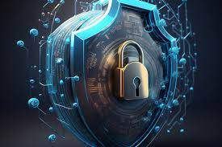

Cases of Cyber-attacks in Africa
Kenyan Banks
(2017)
South African Electricity
Supply (2019)
Ethiopian Government
(2021)
CASES
In May 2017, Kenyan banks experienced a series of Distributed Denial of Service (DDoS) attacks that disrupted their online banking services.
The attacks were attributed to the cybercriminal group, Lazarus, which had previously targeted financial institutions in other countries.
In July 2019, South Africa experienced a series of power outages that affected millions of people.
The outages were attributed to a combination of factors, including technical problems, equipment failures, and cyber attacks.
The exact nature of the cyber attack remains unclear
In June 2021, the Ethiopian government experienced a cyber attack that targeted several government websites and social media accounts.
The attack was attributed to the Tigray People's Liberation Front, a political group that had been in conflict with the Ethiopian government.
The attack disrupted government communications and highlighted the potential for cyber attacks to impact government operations.

Slide 9
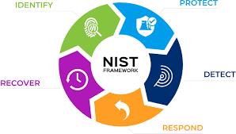
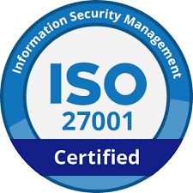
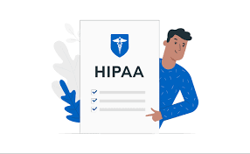
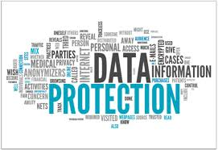
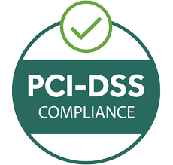
Cyber Security Regulatory Frameworks and Standards
01
02
03
04
05
NIST Cybersecurity Framework
ISO 27001
HIPAA
Data Protection Act (DPA)
The Health Insurance Portability and Accountability Act is a federal law in the United States that sets standards for the privacy and security of health care information by organizations that handle health records.
PCI-DSS
The National Institute of Standards and Technology (NIST) Cybersecurity Framework is a voluntary framework that provides guidelines for organizations to manage and reduce cybersecurity risks.
ISO 27001 is an international standard that provides a framework for managing information security risks by organizations that handle sensitive information.
The Payment Card Industry Data Security Standard (PCI-DSS) is set of security standards designed to ensure that all cardholder information is protected by organizations that handle credit card payments.
The Zimbabwe Data Protection Act is a law that sets standards for the collection, use, and storage of personal data by organizations that operate within Zimbabwe.

Slide 10
Risk Assessment and Management for CNI
The Importance of Conducting Risk Assessment
01
02
03
04
05
Identify potential threats
Assess vulnerabilities
Prioritize security investments
Meet regulatory requirements
Improve incident response
By identifying these threats, organizations can develop appropriate security measures to protect against identified threats..
Organizations develop and implement appropriate security measures to address identified vulnerabilities.
Prioritize security investments by identifying the most critical assets and systems.
Organizations can ensure that they are meeting regulatory requirements and avoiding potential penalties for
non-compliance.
Having a plan in place to address these risks, organizations can respond more quickly and effectively to incidents when they occur.

Slide 11
  Strategies for Managing and Mitigating Cybersecurity Risks
Risk-based approach
Defence-in-depth:
Continuous monitoring
Employee training awareness
Incident Response Planning
Prioritize efforts and resources based on identified risks through regular risk assessments and establishing risk management frameworks.
Implement multiple layers of security controls, combining technical, physical, and administrative measures to create barriers against cyber threats.
Monitor critical infrastructure systems continuously to detect and respond to potential cyber threats promptly.
Invest in regular training and awareness programs to educate employees about cybersecurity best practices and reduce human error and negligence.
Develop and update incident response plans to ensure a coordinated and effective response to security incidents, minimizing their impact.

Slide 12
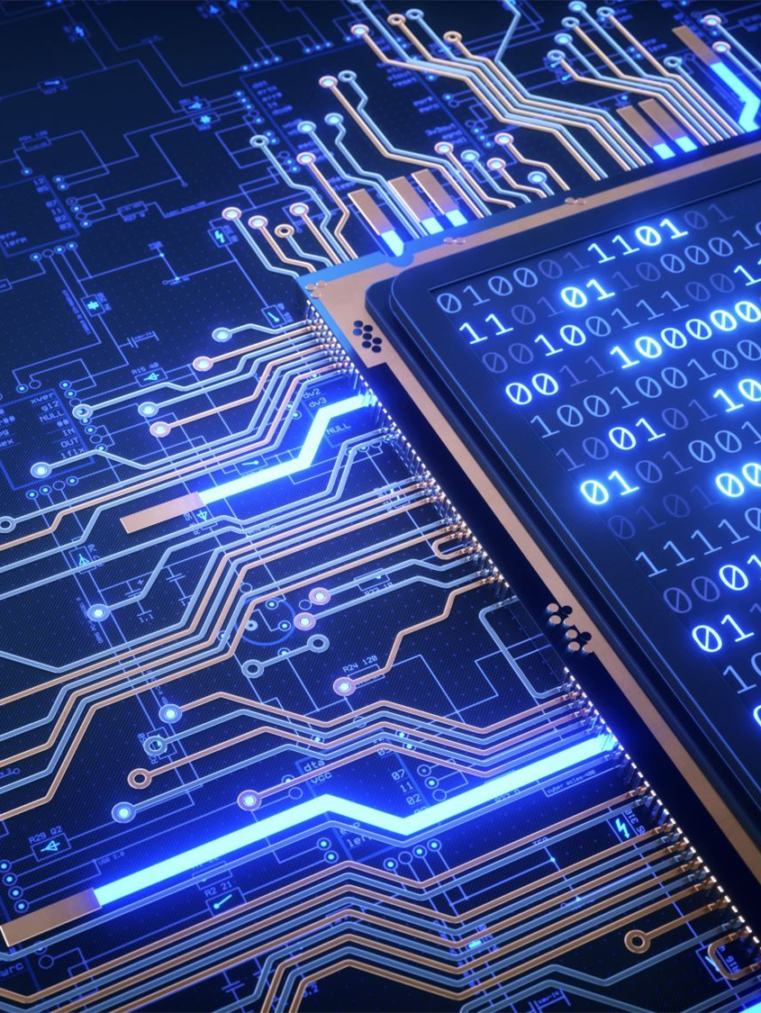
Security Architecture for CNI
08. Stakeholder Collaboration
01. Perimeter Security Controls
Foster collaboration and information sharing
among government agencies, critical infrastructure operators, and industry partners.
Firewalls, Intrusion Prevention Systems (IPS), Virtual Private Networks (VPN)
07. Security Governance and Compliance
02. Identity and Access Management (IAM)
Security Policies and Standards, Regular Audits and Assessments
Multi-factor authentication (MFA), biometric authentication, strong password policies, Least privilege access, Role-based access controls (RBAC), identity governance
06.Cloud Security
03. Data Protection and Encryption:
Cloud Access Security Broker (CASB), Cloud Security Best Practices
Data Encryption, Data Loss Prevention (DLP)
05. Security Monitoring and Incident Response
04. Endpoint Security
Security Information and Event Management (SIEM), Incident Response Plan
Antivirus and Anti-Malware, Endpoint Detection and Response (EDR)

Slide 13

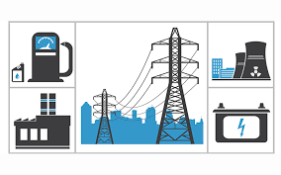

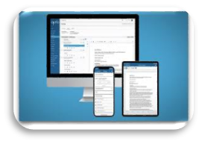


Robust Incident Response Plans
  Minimizing Downtime/damage
Mitigating Economic Impact
  Maintaining business continuity
  Protecting Data and Information
  Enhancing Resilience and Preparedness
  Facilitating Collaboration and Coordination

Slide 14



Handling Incidents
Incident Response Steps
Coordination during cybersecurity incident
Establishment of a National Cybersecurity Strategy
Centralized Coordination
Creation of a National Incident Response Team
Sector-Specific Response Plans
National Threat Intelligence Sharing
Public-Private Partnerships
Enactment of Cybersecurity Laws and Regulations
Training and Skill Development
Incident response team members
IT and security personnel
Senior management and executives
Legal and compliance teams
External cybersecurity experts and consultants
Law enforcement agencies
Government authorities and regulatory bodies

Slide 15

Key Aspects of Resilience
Redundancy and robustness
Resilient infrastructure systems are designed with redundancy and robustness in mind.
Continuity planning
Resilient infrastructure systems have continuity plans in place to ensure the uninterrupted delivery of essential services during and after disruptive events.
Risk assessment and mitigation
Resilience requires a thorough understanding of potential risks and vulnerabilities. Infrastructure operators conduct risk assessments to identify potential threats and implement mitigation measures to reduce the impact of disruptive events.

Slide 16


Key Elements of Continuity Planning
Identifying critical functions, systems, and data to prioritize resources during a cyber-incident.
Backup and Recovery
Regularly backing up critical data, storing securely, and testing for reliability.
Business Impact Analysis (BIA)
Communication and Stakeholder Engagement
Redundancy and Failover
Key Elements in Continuity Planning.
Establishing clear communication lines with teams, partners, and stakeholders, providing regular updates.
Incident Response Plan (IRP)
Building redundant systems to minimize disruption when primary systems are compromised.
Training and Awareness
Outlining steps to contain, investigate, and remediate incidents, regularly tested and communicated.
Regular employee training to recognize and report incidents.

Slide 17
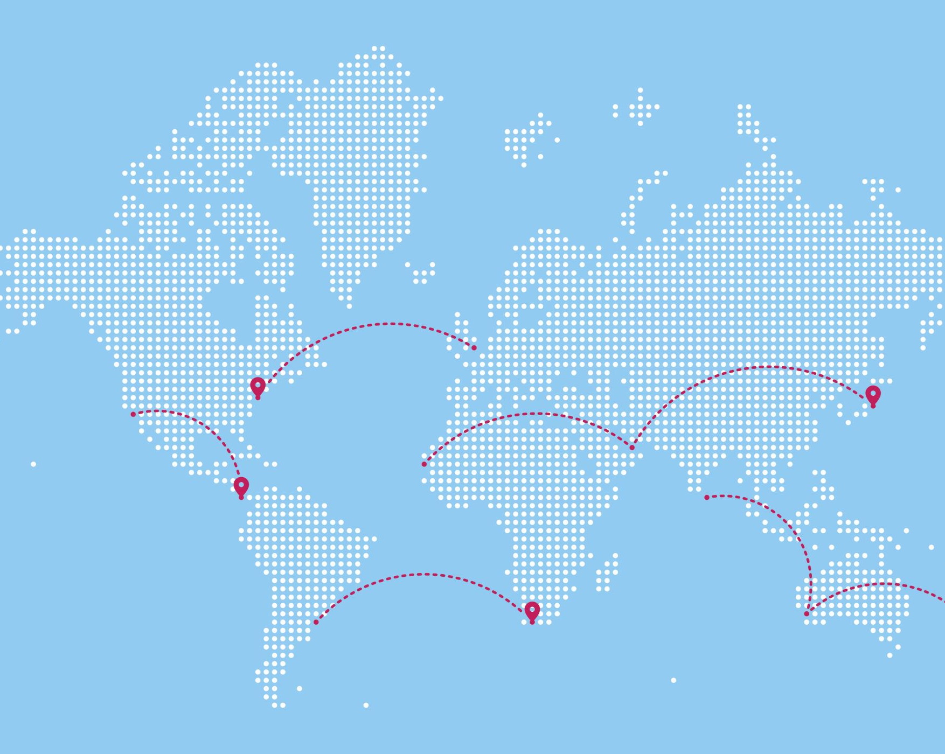
International Cooperation in CNI Security
Global efforts and collaborations in securing critical infrastructure
International organizations: International organizations such as the United Nations, International Atomic Energy Agency (IAEA), and International Maritime Organization (IMO) have established guidelines, standards, and best practices for securing critical infrastructure.
Public-private partnerships: Public-private partnerships have been established to promote collaboration between governments and private sector organizations in securing critical infrastructure.
Cybersecurity collaborations: Cybersecurity collaborations such as the Global Cyber Alliance and the Cybersecurity and Infrastructure Security Agency (CISA) facilitate information sharing, capacity building, and joint exercises to enhance the cybersecurity of critical infrastructure.
Regional collaborations: Regional collaborations such as the European Union Agency for Cybersecurity (ENISA) and the Association of Southeast Asian Nations (ASEAN) have been established to promote collaboration between countries in securing critical infrastructure.

Slide 18

International Norms & Agreements Related to Cybersecurity
UN General Assembly Resolutions: Resolution 70/237 supports international cooperation and the development of norms for responsible state behaviour in cybersecurity.
ITU standards: ITU-T X.1205 guides information exchange on cybersecurity threats between countries and organizations.
Council of Europe Convention on Cybercrime: The first treaty on cybercrime, facilitating international cooperation in investigating and prosecuting cybercrime.
IAEA Nuclear Security Series: Provides guidance on implementing cybersecurity measures in nuclear facilities.

Slide 19

Enhancing Cyber Security Through Advanced Technologies
AI can help improve security by analysing large volumes of data in real-time, identifying patterns, and detecting anomalies or potential threats
Machine learning algorithms can be trained to recognize patterns and behaviours indicative of security breaches or cyberattacks
Blockchain technology can enhance security by providing a decentralized and tamper-proof system for storing and verifying critical data.
5G enables real-time communication, supports massive IoT deployments, and enhances connectivity for devices and systems.
IoT devices monitor assets, improve decision-making, and enhance operational efficiency.
Cloud computing provides on-demand access to computing resources, centralized data storage, real-time analysis, and remote system access.

Slide 20
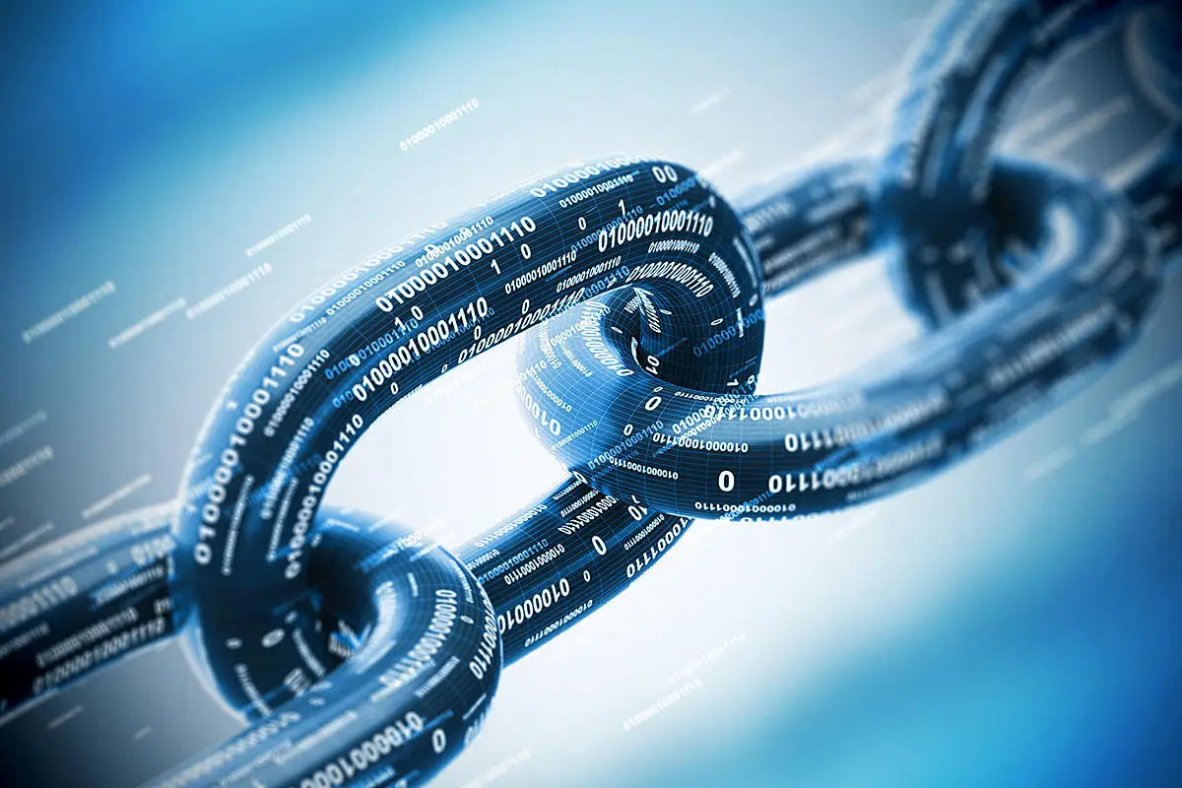
Supply Chain Security
The Importance of securing the supply chain
Preventing Compromises and Attacks
Maintaining Confidentiality and Data Integrity
Ensuring Regulatory Compliance
Preserving Public Trust and Confidence
The supply chain can be vulnerable to various threats, including counterfeit or tampered components, malware injection, or insider attacks
Critical infrastructure components often handle sensitive data and information.
Securing the supply chain ensures adherence to regulations safeguarding CNI from potential legal and regulatory consequences.
Critical infrastructure serves the public interest, and any disruption or compromise can have severe consequences on public safety, economy, and well-being.

Slide 21

Strategies to Ensure Integrity of the Supply Chain
Supplier Evaluation and Selection
Third-Party Audits and Assessment
Secure Communication and Information Sharing
Self-Service DRaas
Supplier Evaluation and Selection
Third-Party Audits and Assessment
Managed DRaaS
Managed DRaaS
Lowest expensive option
It can only be handled by
IT staff
Can be used for in
house expertise
Add text here
Add text here
Conduct thorough assessments and due diligence on vendors and suppliers to evaluate their security practices, track record, and adherence to industry standards.
Managed Draas is an
expensive option
Provide results based on SLA
Provide full support in disaster recovery to enterprises
Add text here
Add text here
Conduct thorough assessments and due diligence on vendors and suppliers to evaluate their security practices, track record, and adherence to industry standards.
Conduct regular audits and assessments of suppliers and vendors to ensure ongoing compliance with security requirements.
Managed Draas is an
expensive option
Provide results based on SLA
Provide full support in disaster recovery to enterprises
Add text here
Add text here
Conduct regular audits and assessments of suppliers and vendors to ensure ongoing compliance with security requirements.
Implement secure communication channels and protocols to exchange sensitive information with suppliers and vendors.

Slide 22

Human Factor in CNI Security
"The protection of Critical Infrastructure lies in an empowered workforce”
Role of employees and personnel in CNI protection
Training programs and awareness campaigns for staff.
Access Controls and Policy Adherence
Insider Threat Mitigation
Security Training and Continuous Learning
Social Engineering Awareness
Effective Crisis Response and Communication
Security Hygiene and Ownership
Policy Enforcement and Adaptive Collaboration
Employee Engagement for Positive Security Culture
Comprehensive Training
Social Engineering and Phishing Awareness
Data Protection and Privacy Measures
Regular Security Awareness Campaigns
Tailored Role-Based Training
Policy Adherence and Compliance
Continuous Learning Initiatives
Employee Engagement for Security

Slide 23

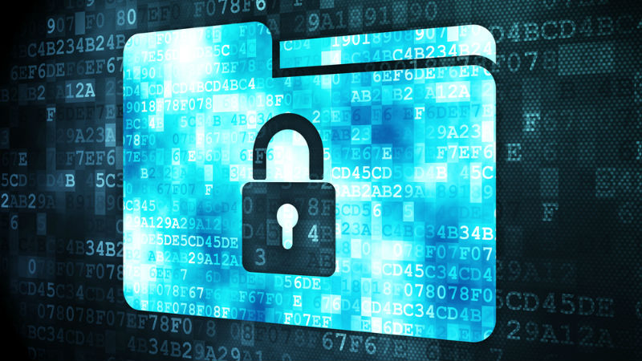


Legislation and Legal Considerations in CNI Security
Legal Frameworks for CNI
Zimbabwe Public Data Protection Act
Commitment to Compliance
Crucial for cybersecurity, especially Zimbabwe's Critical National Infrastructure (CNI).
Compliance is strategic, not just a legal obligation
Local framework guiding data protection.
Compliance showcases commitment to privacy standards.
All Zimbabwean organisations should abide by this.
TelOne goes beyond legislation; it's proactive in fortifying CNI security.
TelOne fully complies to all legalities that govern the national cyberspace, particularly the Public Data Protection act.
This positions us at the forefront of defending against cyber threats.

Slide 24
Recommendations for CNI Protection
01
Establish a centralised National Cybersecurity Authority to coordinate and oversee cybersecurity efforts for CNI
Develop a comprehensive regulatory framework, addressing cybersecurity standards, incident reporting, and compliance requirements.
02
Conduct regular cybersecurity risk assessments to inform adaptive security strategies and ensure proactive defence.
03
Foster public-private partnerships (PPPs) and facilitate information sharing, joint cybersecurity initiatives, and resource pooling..
04
Establish a National Incident Response Plan, defining clear roles, responsibilities, and communication channels, and ensure its regularly updated.
05
Invest in cybersecurity awareness and training, and allocate resources for R & D in cybersecurity - hence develop build a capable and innovative workforce..
06
Regularize information sharing and cross-sector collaboration, and international collaboration and standardisation for collective defence against cyber threats.
07
Develop and enforce sector-specific cybersecurity standards, and ensure compliance through regular audits and assessments.
08
Enhance critical infrastructure resilience through technologies and strategies, including redundancy measures, secure backup systems, and disaster recovery plans specific to CNI.
09

